Slide 1

Joining forces on research - SAF€RA activities Olivier SALVI President of INERIS DEVELOPPEMENT ETPIS Secretary General and Vice-Chairman of SAF€RA

Slide 2
Outline
Background information on ETPIS
Investment in research on industrial safety over the last 10 years in relation with ETPIS
SAF€RA: Emergence of a new collaborative work programme on industrial safety
History of previous calls
Update on on-going call
Implementation of research results

Slide 3
Part I Background information on ETPIS

Slide 4
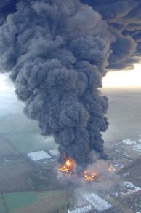
ETPIS profile & key figures
3 missions:
Strategy - Programming
Mobilizing - Brokerage
Dissemination
12 projects (50 M€) on safety issues funded by the EC since FP7 in NMP:
Integrated risk management
Personal protective equipment
Organizational safety
Ageing of infrastructures & industrial plants
ERANET SAF€RA
Other projects on nanosafety, energy, security…
Cross-ETP: cooperation with a large network of other ETPs, Associations and Institutions
Research programming evolution: bottom-up > societal challenges > end-user driven
An instrument created in 2005 to pilot and defragment EU research investment in industrial safety (OHS, process safety & environmental safety, emerging risks)
Vision & Strategic Research Agenda
SafeFuture
SAF€RA PARTNERSHIP (ERANET)
Buncefield, 11 De. 2005 (UK)
An open forum with 850+ experts to share ideas, prepare future work & disseminate results
Focus groups, National Platforms on industrial safety & security
Technical Wokshops & Conferences
Education and Training
A platform driven by industry with a High Level Group with representatives from Chemical, Oil, Car, Energy, Transport, Food, Re-insurance, Construction, Manufacturing, Defense and EU-OSHA

Slide 5
Industrial Safety & Security in Horizon 2020
Conventional risks improving the safety performance in all industry sectors and reducing the impact of accidents taking into account technical, human, organisational and cultural aspects, and the current ‘state-of-the-art methods’ for safety management.
Innovative industry accompanying the innovative industry to reduce the time to the EU market and reach public acceptance of new technologies and products by implementing e.g. the CEN Workshop Agreement CWA 16649:2013 ‘Managing emerging technology-related risks’ adopted on June 26, 2013
Safety & security technologies, products & services guaranteeing the leadership of the EU safety industry on personal protective equipment, safety systems, sensors, inspection and control...

Slide 6







Achievements of ETPIS Projects – Network – Joint Programming
Network
Programming
Projects
About 800 registered stakeholders
50 active institutions/companies Partner associations (industry, scholarship, scientific, clusters…)
12 projects funded by the EC since FP7 in NMP
Integrated risk management
Personal protective equipments
Organizational safety
Ageing of infrastructures and industrial plants
ERANET SAF€RA
More projects funded in other parts of the EC Work Programme
SRA 2006
HLG priorities
SafeFuture (consultation of the members)
SAF€RA Research Programming (ERA-NET)

Slide 7
Part II Investment in research on industrial safety over the last 10 years in relation with ETPIS

Slide 8
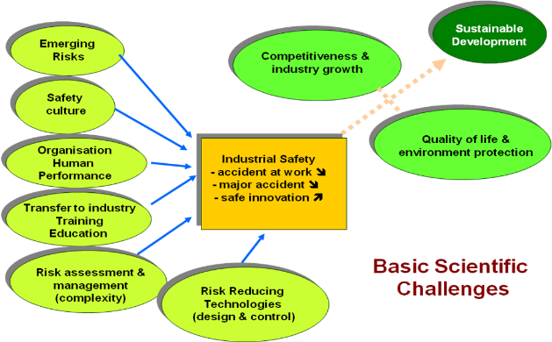

Evolution of research programming in industrial safety
1
SRA 2006: a bottom up & thematic approach
SafeFuture 2010 – 2020 (FP 7) based on the Grand Challenges
Safe Energy
Safe Infrastructures
Safe Production & Products
Cross cutting issues
2
3
Horizon 2020: Safety as a cross-cutting issue
Industrial Technologies (NMBP & LEIT)
Energy
Environment
Secure Societies
“Safety for a sustainable and competitive future”

Slide 9
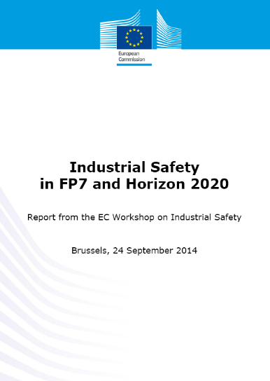
EC Industrial Safety WS, September 2014
On September 24, 2014 the European Commission, with the support of ETPIS, organised a Workshop on Industrial Safety in Brussels.
The aim was to discuss with the different industrial stakeholders the interest of taking safety into account as a cross-cutting issue in the different PPP topics, similarly to what is done with sustainability.
See: http://ec.europa.eu/research/industrial_technologies/event-14-programme_en.html

Slide 10


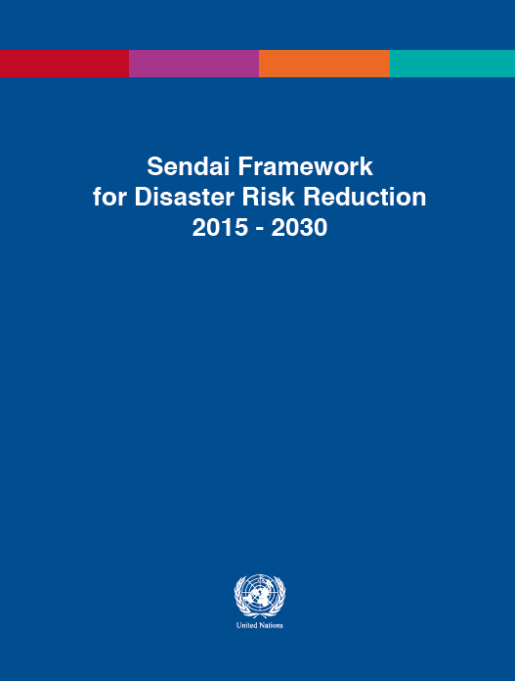

Open innovation & sustainable growth
Climate change
Clean energy
Sustainable transport
Sustainable industrial production
Aging population
EU Grand Challenges
Embedded safety
Emerging risk management
Safe Innovation
Sustainable growth
Smart growth
Innovation /
education
Sustainable growth climate/energy/ mobility
competitiveness
Inclusive poverty
Embedded safety and emerging risk management for a competitive Europe

Slide 11
Today main drivers that have an impact on industrial safety
Industry 4.0
IoT
Energy transition
Globali-sation
Threats
Smart cities
Big Data
Nano-revolution
Climate change
…

Slide 12
Part III SAF€RA: Emergence of a new collaborative work programme on industrial safety

Slide 13























SAF€RA: Emergence of a new collaborative work programme
2013: 1st joint call on “Human and organizational factors including the value of industrial safety”
53 applications (requesting 9.44 M€)
12 projects funded (3.4 M€)
2014: 2nd joint call on “Innovating in safety and safe innovations”
42 applications from 19 countries (requesting 8 M€)
9 projects funded (about 2 M€)
2015: 19 organisations funding research on industrial safety decided to create the SAF€RA Partnership to continue operating the ERANET. EPSC (EU industry association) and IOSH (international org.) joined
2016: 3rd joint call (on-going) with approx. 1.6 M€ available
T1: Big data and intelligent prognostics for life extension of aging facilities
T2: Developing professional competencies and learning from experience
2017: Inclusion of a nanosafety programme & preparation of the 4th joint call New members: Government of Navarra, GRST, BMVIT

Slide 14
SAF€RA: Emergence of a new collaborative work programme
Example of funded projects (http://projects.safera.eu/)
Value of Safety — VaLoSa
Success in the face of uncertainty: human resilience and the accident risk bow-tie
Predictive methods for determining the decomposition properties of hazardous substances: from development to experimental verification — HAZPRED
SAfety Preferences for Health-related Industrial Risks – SAPHIR
Exploring contributions of civil society to safety — ECCSSafe
Training for Operational Resilience Capabilities — TORC
SocioTechnical safety Assessment within Risk Regulation Regimes – STARS
Promoting safety as an emergent property of a resilient system
Improving resilience in waste transports
Development and validation of a KPI-based method and a user-friendly software tool for resilience-focused measurement of OSH management system performance — KPI-OSH-Tool
Forecasting Safety with Smart Working Environments — ForSafety
Smart Process INdustry CranEs — SPRINCE
Building a European platform for evaluation of consequence models dedicated to emerging risks — SAPHEDRA

Slide 15

Consultation to identify priorities for research
The period of consultation started from February 22, and ended on April 14, 2017
Distribution to ETPIS, EU-VRi and SAF€RA registered stakeholders
49 contributions were collected, from 36 organizations, on the following topics:
Occupational Health and Safety
Human and organisational factors, safety culture
Process safety, nanosafety
Risk reduction technologies, reliability of systems
Methodologies for risk assessment and risk management
Environmental safety and health related to industrial activities
Security of critical infrastructures, CBRNe, disaster resilience and business continuity
Safety performance and key performance indicators
Other
Inputs for the 4th SAF€RA call published in November 2017 (on-going; more than 25 pre-proposals received)
Topic 1. New technologies and the effects of major changes in industry
Topic 2. Measuring and monitoring safety performance

Slide 16
Part V Implementation of research results

Slide 17
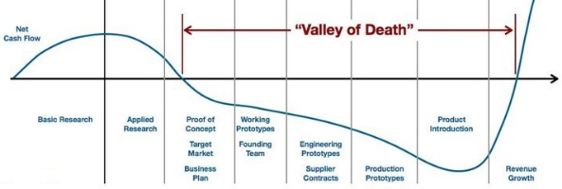
Implementation of R&D results: still a challenge!
Usual delay from new knowledge to implementation
New knowledge requires to change the habits and existing procedures… it takes time to be implemented, sometimes several years
Changes in the regulation
Changes in the practices
E.g. Seveso accident in 1976 => Seveso directive in 1982
From Strategic Alliances Resources Network, LLC (StarNet, LLC), http://www.starnetllc.net/

Slide 18
Implementation of R&D results: still a challenge!
For safety & security, R&D results are inputs to make decision
We can observe:
Decision makers often react emotionally
There are often reactive changes of regulation and practices, after significant accidents
Risk management should be about managing risks and uncertainties in a given context, proactively and not reactively

Slide 19
Implementation of R&D results: still a challenge!
As a researcher, how can I facilitate or contribute to the implementation of my results?
Several strategies to improve the implementation of R&D results:
Involve the end-users and stakeholders in the programming (e.g. CoU, FIRE-IN) and in the research (e.g. SAF€RA requirement)
Outreach standards for use by practitioners (e.g. nanoSTAIR)
Publish guidelines and methods on the internet
Disseminate outside the scientific community and contribute in implementation projects (e.g. CBRNe Centers of Excellences from DG DEVCO & UNICRI)

Slide 20
Role of experts and expert Institutes
Experts and expert institutes have a key role to:
Develop knowledge in relations with the scientific community
Provide technical support to the industry to design new technological solutions
Help authorities to develop policies and regulations to guarantee a high level of protection for the society
Public Authorities
Experts
Scientific community
Industry

Slide 21
Wrap-up

Slide 22

Wrap-up
ETPIS has become over 12 years of operation, an instrument to coordinate and defragment the research investment in industrial safety and security. This is now organized thanks to the relation with the European Commission and SAF€RA Partnership engaging national funading organizations. It has helped to build and to animate a community made of professionals (RTOs, industry, consulting companies, academics, trade unions, NGOs…).
Embedded safety and security research to accompany the technological developments is necessary to assure sustainable solutions.
Focused research on industrial safety is also needed, e.g. on:
The impact of the industry transformation (digitalisation, IoT, demographical changes, globalisation…)
Understanding the hazardous phenomenon in relation with LOW-CARBON ENERGY (CO2 storage, LNG, Hydrogen, batteries…)
Safety performance & indicators, effective reporting
Safety culture, and organizational safety
Costs of accidents vs cost of prevention
R & D projects should pay more attention to the implementation of the results and propose a sound strategy and specific activities during projects
Involvement of stakeholders & end-users during the research
Preparation of guidelines and standards to share the results
Disseminate in the research community but also to practitionners and professionnal networks

Slide 23
Contact:
http://www.industrialsafety-tp.org
Olivier.salvi@ineris-developpement.com

